Slide 1
Data Science Workshop Session 4
Ikenna Ivenso
04 July 2020

Slide 2
Objectives
Recap – When to Use Machine Learning
Supervised vs Unsupervised Learning
Two Common Supervised Learning Problems – Regression & Classification
Demos (Classification and Regression)

Slide 3
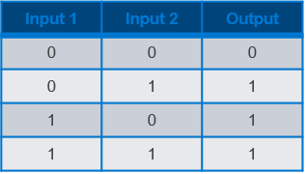
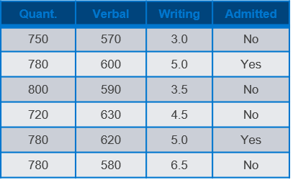
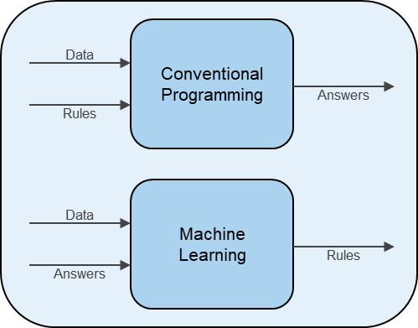
When to Use Machine Learning
Machine Learning is useful when
“Rules” are not obvious OR too difficult to code
A problem is a good candidate for Machine Learning if
A reasonable amount of data exists
A pattern exists in the data
The pattern is difficult to figure out

Slide 4
Supervised vs Unsupervised Learning
Supervised Learning:
If an ML task involves a dataset that contains both the input variables and output variables, then that task is a Supervised Learning task.
One can train a model to correctly map the inputs to the outputs.
Unsupervised Learning:
If, on the other hand, an ML task involves a dataset that contains only the input variables, then that task is an Unsupervised Learning task.
One can try to discover the underlying patterns in which the data is organized.

Slide 5
Regression vs Classification
Regression:
If a task involves predicting a continuous quantity, then it is a regression problem
Example: How much can I sell my car for ? – (e.g. N302,000)
Classification:
If the task involves predicting a category or type, then it is a classification problem
Example: Will my students be adimitted into the Masters degree program ? - (e.g. Yes/No)

Slide 6

THANK YOU! Any Questions

